Slide 1
Test Case writing techniques
Alaa Gamal

Slide 2
Part3

Slide 3

Agenda
What is a Defect?
How to write a defect?
Defect major fields
Defect Life Cycle
Defect Management Process
Different types of defects
Samples for defects

Slide 4
What is a Defect?
A defect or bug is flaw in any software system that can cause the software system to fail to perform what its actually supposed to perform.
A defect gets introduced in software work product due to the mistake made by the person creating that software work product like software requirements, design documents (High Level Design/Detailed Design), Test Plan, Test Scripts, Software Code etc.
A Software Defect / Bug is a condition in a software product which does not meet a software requirement (as stated in the requirement specifications) or end-user expectations (which may not be specified but are reasonable).
In other words, a defect is an error in coding or logic that causes a program to malfunction or to produce incorrect/unexpected results.
4

Slide 5
How to write a defect?
Bug reporting is an important aspect of software testing.
An effective bug report communicates well with the development team and avoids confusion or miscommunication.
A good bug report should be clear and concise without missing key points. Any lack of clarity leads to misunderstanding and slows down the development process.
Defect writing and reporting is one of the most important areas in testing
life cycle.
Good Writing is an important process of filing a bug.
5

Slide 6
How to write a defect?
An important thing that a tester should keep in mind is not to use commanding tone in the report. This breaks the morale and creates an unhealthy work relationship. Use suggestive tone.
It is also important before reporting to check of same bug has been reported or not.
A duplicate bug is a burden in testing cycle. Check the list of known bugs. It might happen that developers had known the issue and ignored for future release.
6

Slide 7
How to write a defect?
The import information that a bug report must communicate is “How?” and “Where?” The report should clearly answer how the test was performed and where the defect occurred.
The reader should easily reproduce the bug and find where the bug is.
Keep in mind the objective of writing the bug report is to enable the developer to visualize the problem.
He/ She should understand the defect from the bug report.
Remember to give all the relevant information that the developer is seeking.
7

Slide 8
How to write a defect?
Also keep in mind that a bug report would be preserved for future use and should be well written with required information.
Use meaningful sentences and simple words to describe your bugs. Don’t use confusing statements that wastes the time of reviewer.
A bug report should be clear and concise.
8

Slide 9
How to write a defect?
Report each bug as a separate issue. In case of multiple issues in single bug report, you can’t close it unless all the issues are resolved.
Hence it is best to split the issues into separate bugs. This ensures that each bug can be handled separately.
A well written bug report helps developer to reproduce bug at their terminal. This helps them to diagnose the issue.
9

Slide 10
Defect Fields
Defect ID
Title Summary
Description
Precondition
Steps to reproduce
Expected Result
Defect
Actual Result
Attachments
Type
Status
Created By

Slide 11
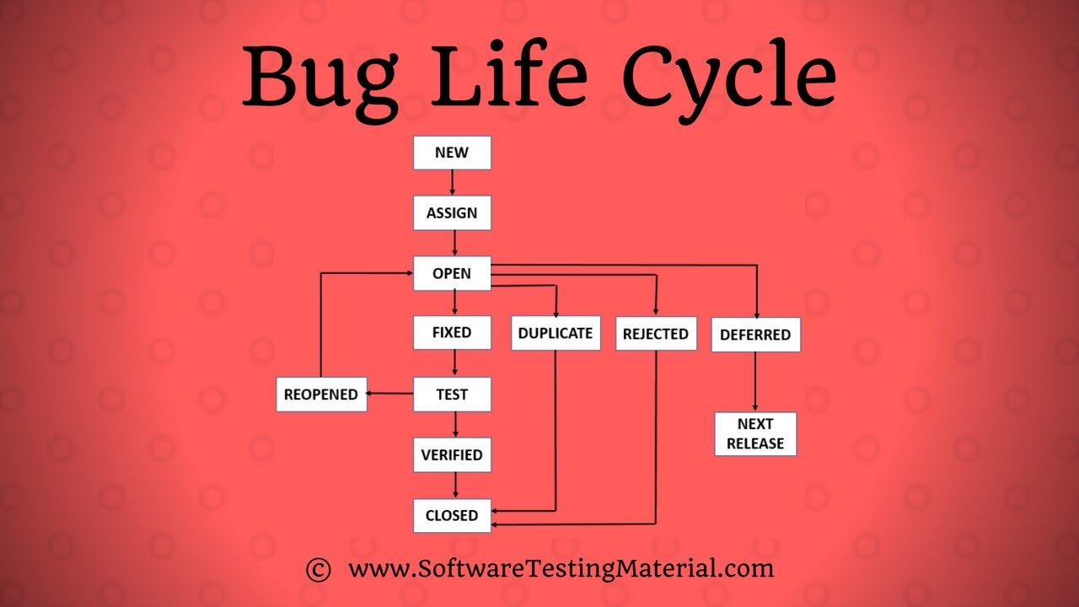
Defect Life Cycle
11

Slide 12
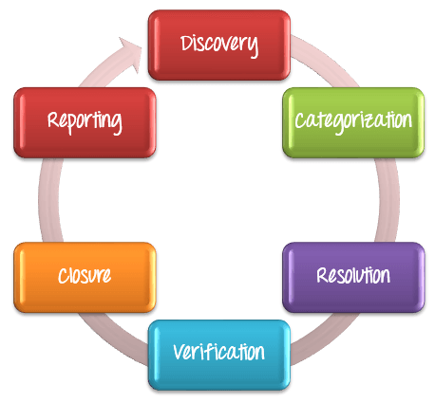
Defect Management Process
12

Slide 13
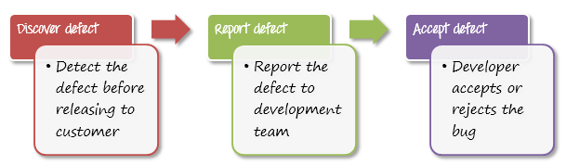
Discovery
13
Notes:
In the discovery phase, the project teams have to discover as many defects as possible, before the end customer can discover it.
A defect is said to be discovered and change to status accepted when it is acknowledged and accepted by the developers

Slide 14
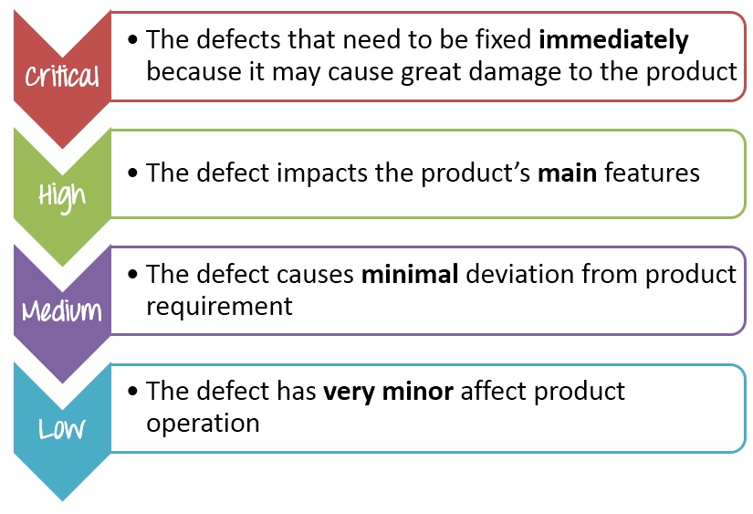
Categorization
14
Notes:
Defect categorization help the software developers to prioritize their tasks. That means that this kind of priority helps the developers in fixing those defects first that are highly crucial.

Slide 15
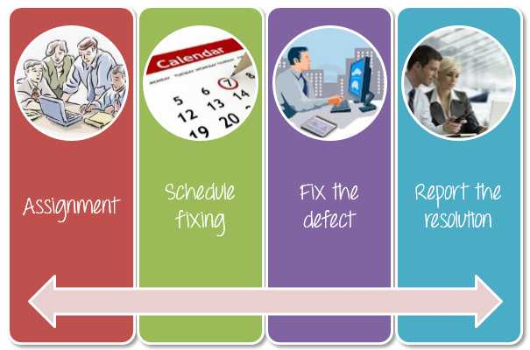
Resolution
15
Notes:
Once the defects are accepted and categorized, you can follow the following steps to fix the defect.

Slide 16
Resolution
Assignment: Assigned to a developer or other technician to fix, and changed the status to Responding.
Schedule fixing: The developer side take charge in this phase. They will create a schedule to fix these defects, depend on the defect priority.
Fix the defect: While the development team is fixing the defects, the Test Manager tracks the process of fixing defect compare to the above schedule.
Report the resolution: Get a report of the resolution from developers when defects are fixed.
16

Slide 17
Verification
After the development team fixed and reported the defect, the testing team verifies that the defects are actually resolved.
17

Slide 18
Closure
Once a defect has been resolved and verified, the defect is changed status as closed. If not, you have send a notice to the development to check the defect again.
18

Slide 19
Reporting
The management board has right to know the defect status. They must understand the defect management process to support you in this project. Therefore, you must report them the current defect situation to get feedback from them.
19

Slide 20
Defect Priority
Indicates the importance or urgency of fixing a defect.
Though priority may be initially set by the Software Tester, it is usually finalized by the Project/Product Manager.
Priority can be categorized into the following levels:
Urgent: Must be fixed immediately / in the next build.
High: Must be fixed in any of the upcoming builds but should be included in the release.
Medium: May be fixed after the release / in the next release.
Low: May or may not be fixed at all.
20

Slide 21
Defect Priority
Priority is determined by considering the following:
Business need for fixing the defect
Defect Severity /Impact
Defect Probability /Visibility
Available Resources (Developers to fix and Testers to verify the fixes)
Available Time (Time for fixing, verifying the fixes and performing regression tests after the verification of the fixes)
Defect Priority needs to be managed carefully in order to avoid product instability, especially when there is a large of number of defects.
21

Slide 22
Defect Probability
Indicates the likelihood of a user encountering the defect / bug.
Also known as Defect Visibility or Bug Probability or Bug Visibility,
Probability can be categorized into the following levels:
High: Encountered by all or almost all the users of the feature
Medium: Encountered by about 50% of the users of the feature
Low: Encountered by very few users of the feature
22

Slide 23
Defect Probability
Defect Probability can also be denoted in percentage (%).
The measure of Probability/Visibility is with respect to the usage of a feature and not the overall software.
Hence, a bug in a rarely used feature can have a high probability if the bug is easily encountered by users of the feature. Similarly, a bug in a widely used feature can have a low probability if the users rarely detect it.
23

Slide 24
Defect Severity
Is a classification of software defect (bug) to indicate the degree of negative impact on the quality of software.
can be categorized into the following levels:
Critical: The defect affects critical functionality or critical data. It does not have a workaround. Example: Unsuccessful installation, complete failure of a feature.
Major: The defect affects major functionality or major data. It has a workaround but is not obvious and is difficult.
Example: A feature is not functional from one module but the task is doable if 10 complicated indirect steps are followed in another module/s.
24

Slide 25
Defect Severity
Minor: The defect affects minor functionality or non-critical data. It has an easy workaround. Example: A minor feature that is not functional in one module but the same task is easily doable from another module.
Trivial: The defect does not affect functionality or data. It does not even need a workaround. It does not impact productivity or efficiency. It is merely an inconvenience.
Example: Petty layout discrepancies, spelling/grammatical errors.
25

Slide 26
Defect Severity
Severity is also denoted as:
S1 = Critical
S2 = Major
S3 = Minor
S4 = Trivial
Testers have the final say on Defect Severity while the Project Management / Product Management /Client has the final say on Defect Priority.
26

Slide 27
Thanks!

